Slide 1


Design Space Exploration Introduction
Carl Gamble, Newcastle University
www.into-cps.org

Slide 2
Contents
Running Example
Concepts
What is the design space
How can we measure and compare designs
How can we explore it
More detail and a small demo
A DSE workflow
Details of how concepts are represented in INTO-CPS
A demo of the tooling
Future Directions

Slide 3
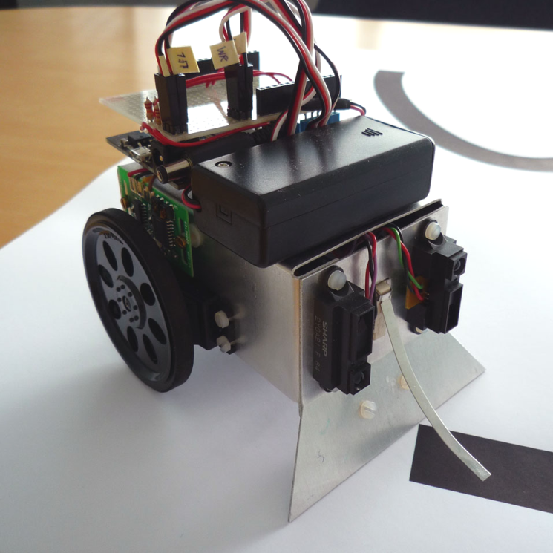

Line Follower Robot
Wheels and servo motors
Small robot with:
Two wheels with servos
Two wheel encoders
Two infrared sensors
Goal:
Use the sensors to follow the line
Handle a single sensor failure
Example path
Wheel encoder
Infrared sensors

Slide 4
Design Space - Parameters
Design parameters have numeric or token values that define some property of the CPS
Parameters can define physical or cyber properties
Multiplying the potential number of values for each parameter defines the architecture’s design space.
Line follow robot has 9 positions for each sensor -> 81 potential designs
We may want constraints on parameters to yield only sensible combinations

Slide 5
Design Space - Architecture
Designs that differ in more than just parameter values
Architectures may share some parameters
Line follow robot could have different numbers of sensors

Slide 6


Design Space - Scenarios
Scenarios describe the environment around the CPS
Designs may be optimised for particular scenarios
Need diversity in testing scenarios
Scenarios can help assess different requirements
This affects both simulation models and objective scripts

Slide 7
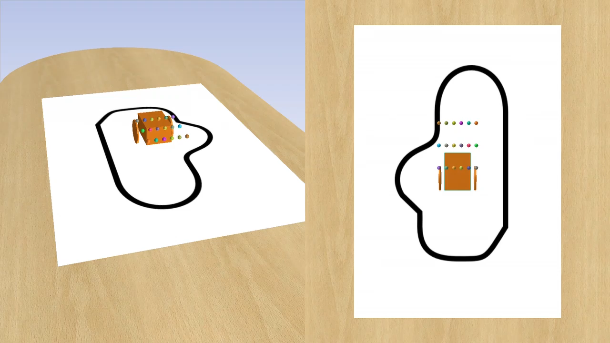
All Results

Slide 8
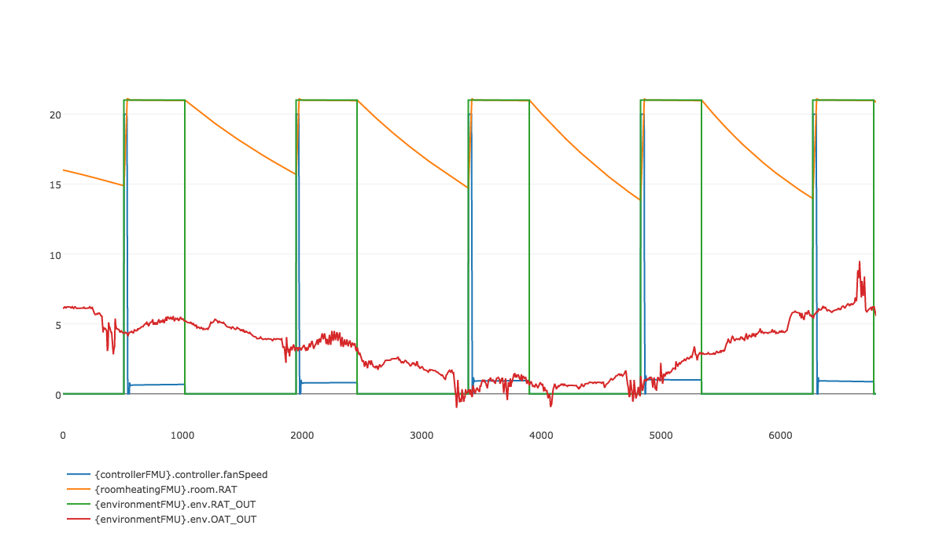
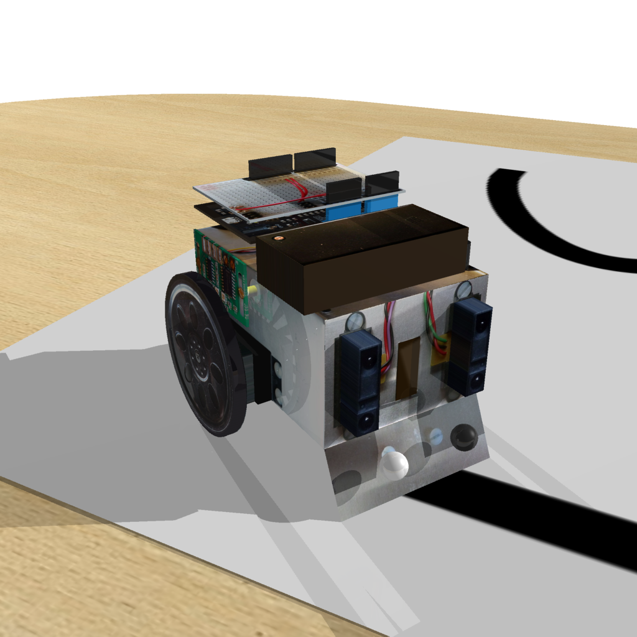
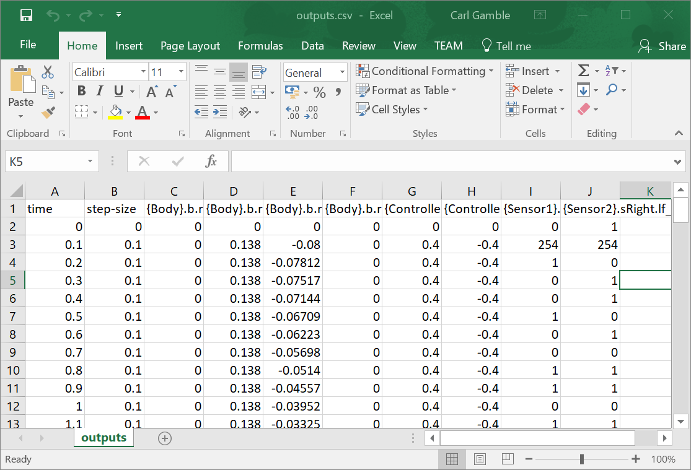
Objectives
Live graphs and raw results are good for debugging CPS design and understanding behaviour
They are not so good for automatically comparing two or more designs
Need measures that characterise behaviour of the modelled system.
We call these ‘objectives’ and they process the raw simulation data to output measures that allow direct comparison of results.
For the line follower we have cross track error and lap time

Slide 9
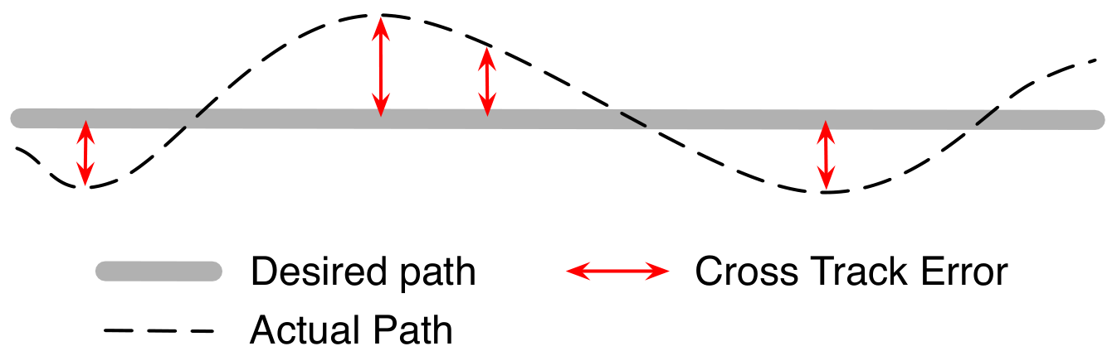
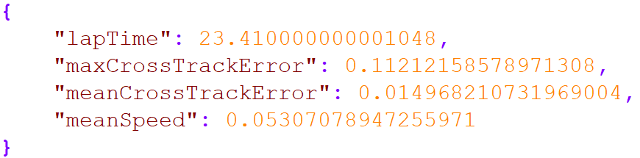
Objective Evaluation
Map
(scenario data)
Raw data:
Robot track
(simulation results)
Cross track error
Lap time
Objective
evaluation:
Mid point
Start/Stop
Objective
values:

Slide 10
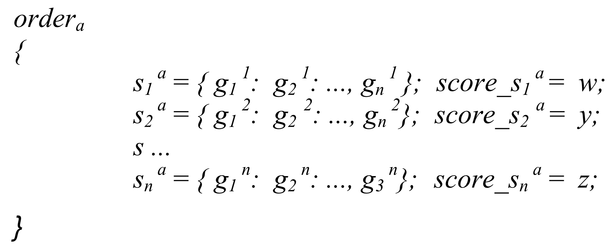
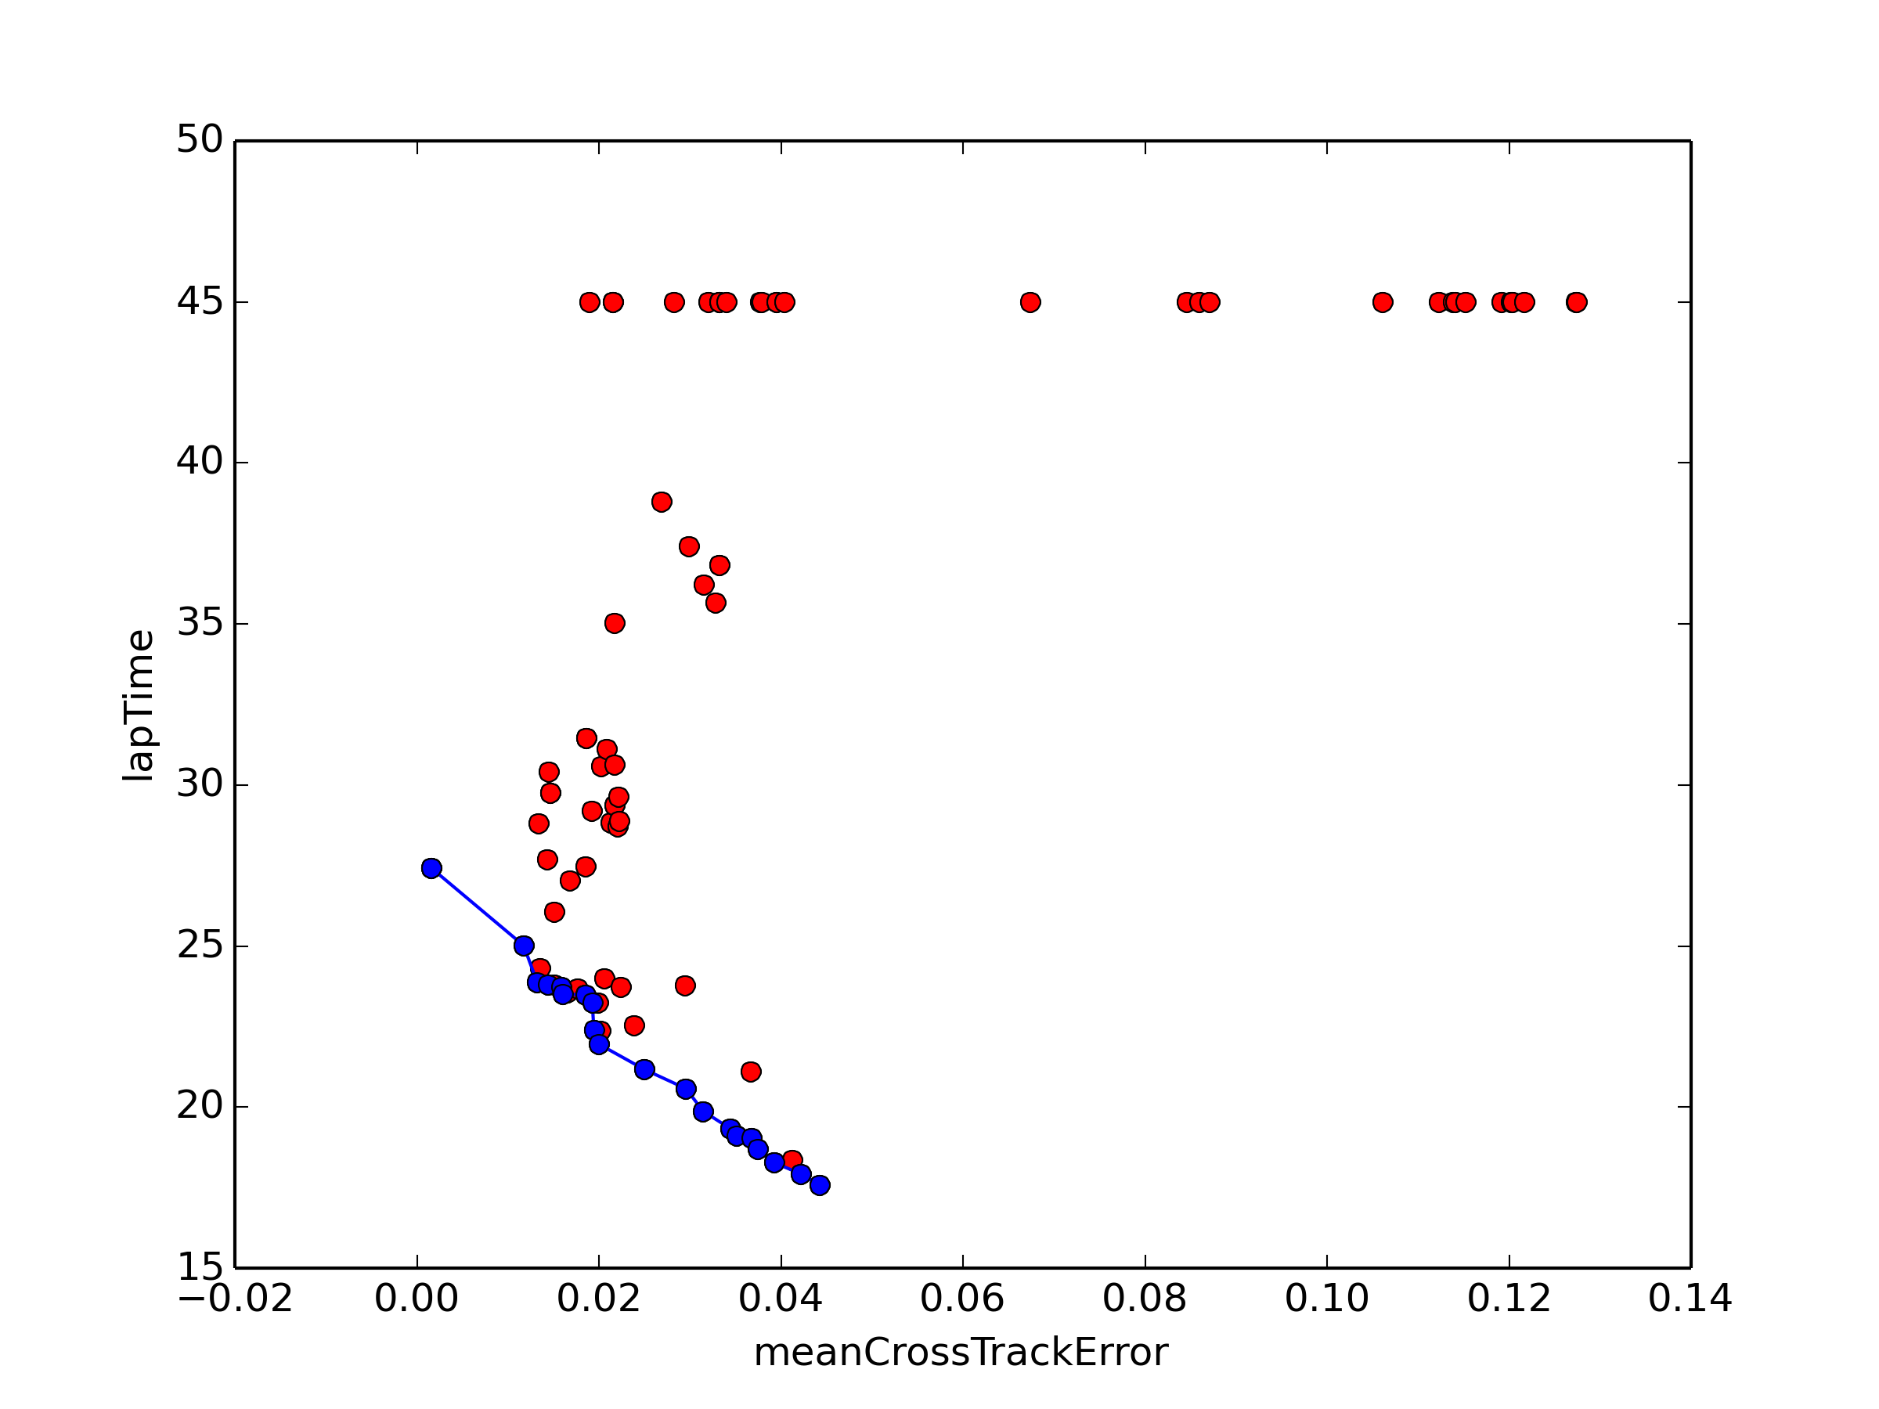
Ranking and Trade-off
Weighted additive method
Trade-off preferences
well understood:
Enumeration and scoring
Trade off preferences
Not well understood:
Pareto analysis

Slide 11
Search Algorithms
Open Loop: Exhaustive search:
Pro: simulates all combinations and so the global optimum will be found
Con: attempts to simulate all combinations and so may not complete in a realistic time
Closed Loop: Genetic Search, Simulated Annealing:
Pro: makes use of ranking information and iteration to attempt to home in on better designs
Con: Generally includes random elements so not repeatable and may find local rather than global optimum

Slide 12
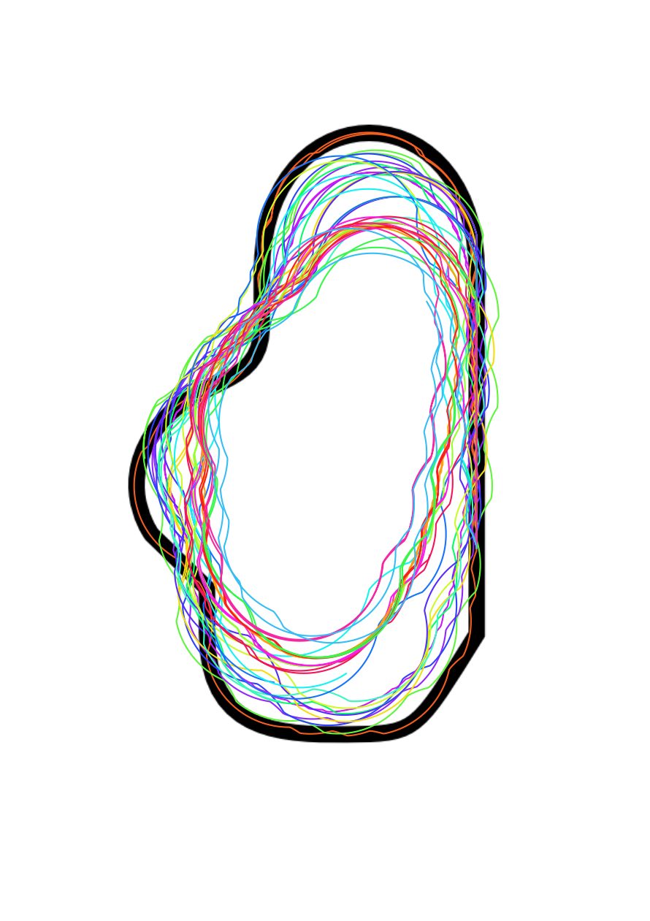
Pareto Front

Slide 13
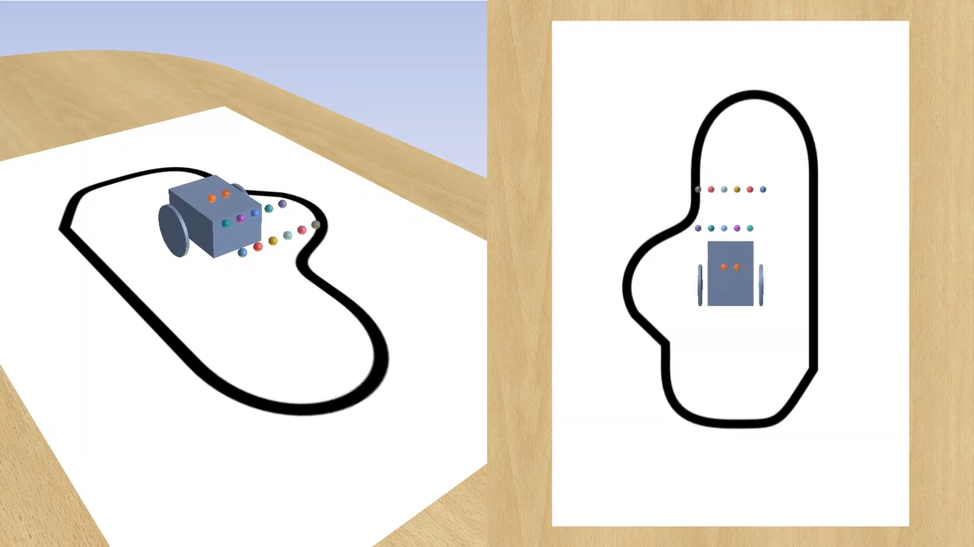
Pareto Front (Speed vs Error)

Slide 14
We have seen concepts…
... Now into a little more detail and example

Slide 15
A DSE Workflow
Requirements
Multi-model
DSE Analysis
Modelio
DSE Analysis Model
Configuration Export
Modelio
Objective Scripting
Python/Java
DSE Configuration
Objective Scripts
Configuration Editing
INTO App.
DSE Configuration
Launch DSE
INTO App.
Simulation Results
Objective Results
Ranking Results

Slide 16
DSE in SysML
DSE analysis begins in SysML, where it has the potential to be linked to requirements
Outlines what the design space is and how to assess designs
Currently consists of 5 views referred to as the DSE SysML profile
Parameters definition (2 views)
Objectives Definition (2 views)
Ranking Definition
Developing a 6th view describing scenario changes

Slide 17
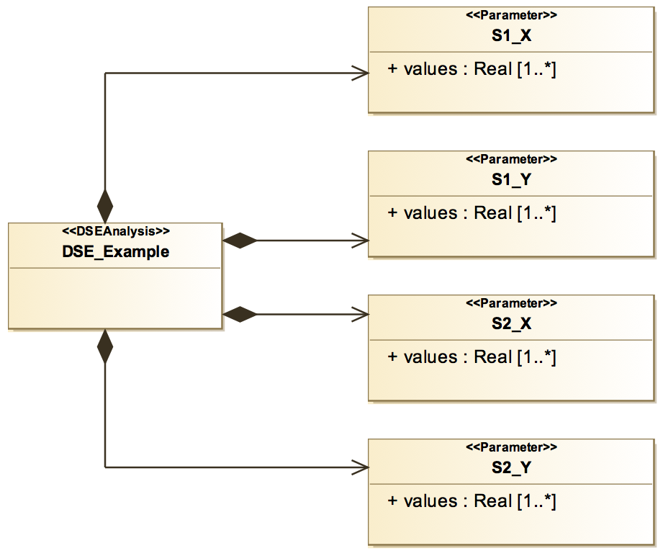
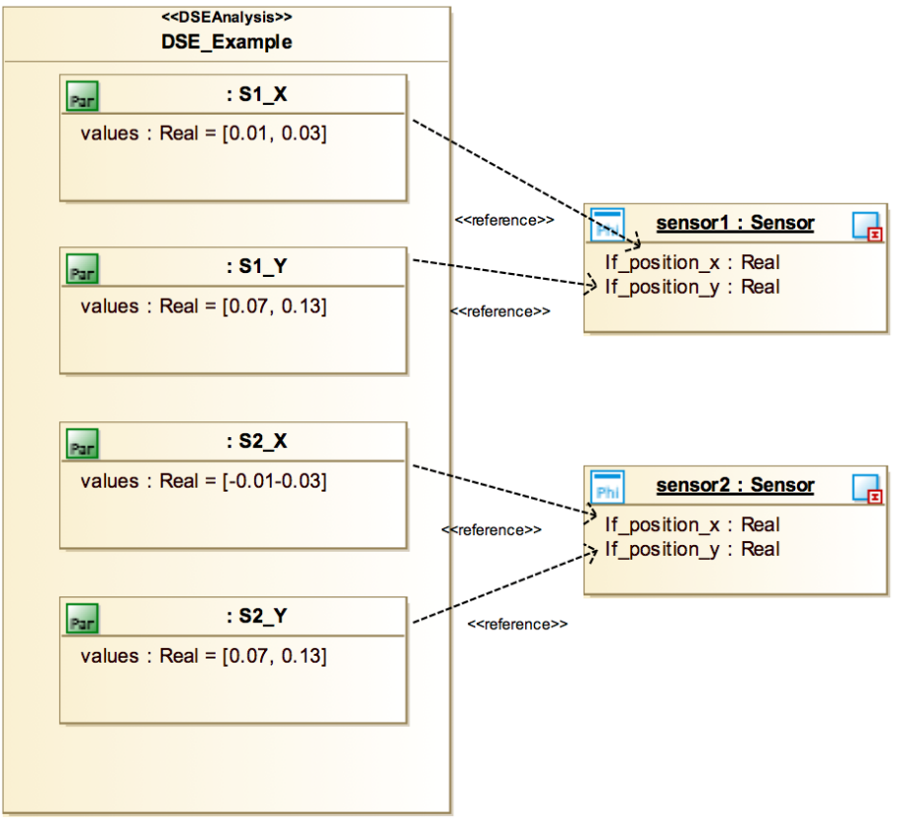
DSE in SysML - Parameters
Parameter definitions
ID
Type
List of values
Mapped to
FMU instance
parameters
Parameter
instances
DSE object
Parameters definition
Mapping to Multi-model

Slide 18
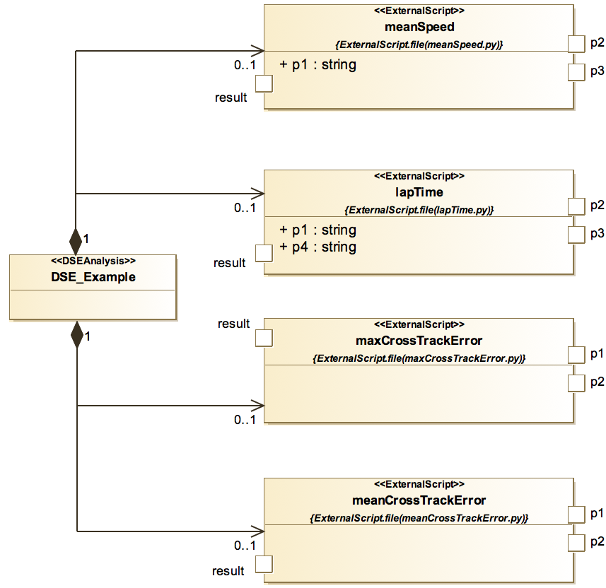
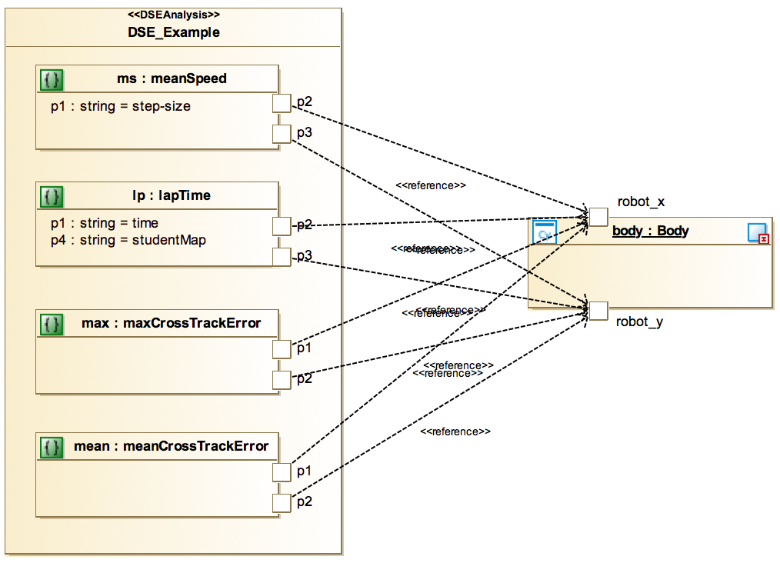
DSE in SysML - Objectives
Objective definitions
ID
Script file
List of required data
Variable inputs
Mapped to FMU
instance outputs
Objective
instances
DSE object
Objectives definition
Mapping to Multi-model

Slide 19
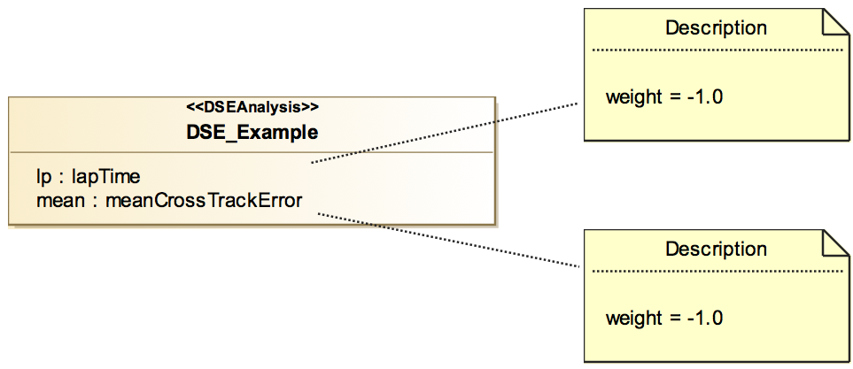
DSE in SysML - Ranking
Objective IDs
Weighting defines preference:
-1 = lower preferred
+1 = higher values preferred
Ranking defines what to include in Pareto analysis

Slide 20
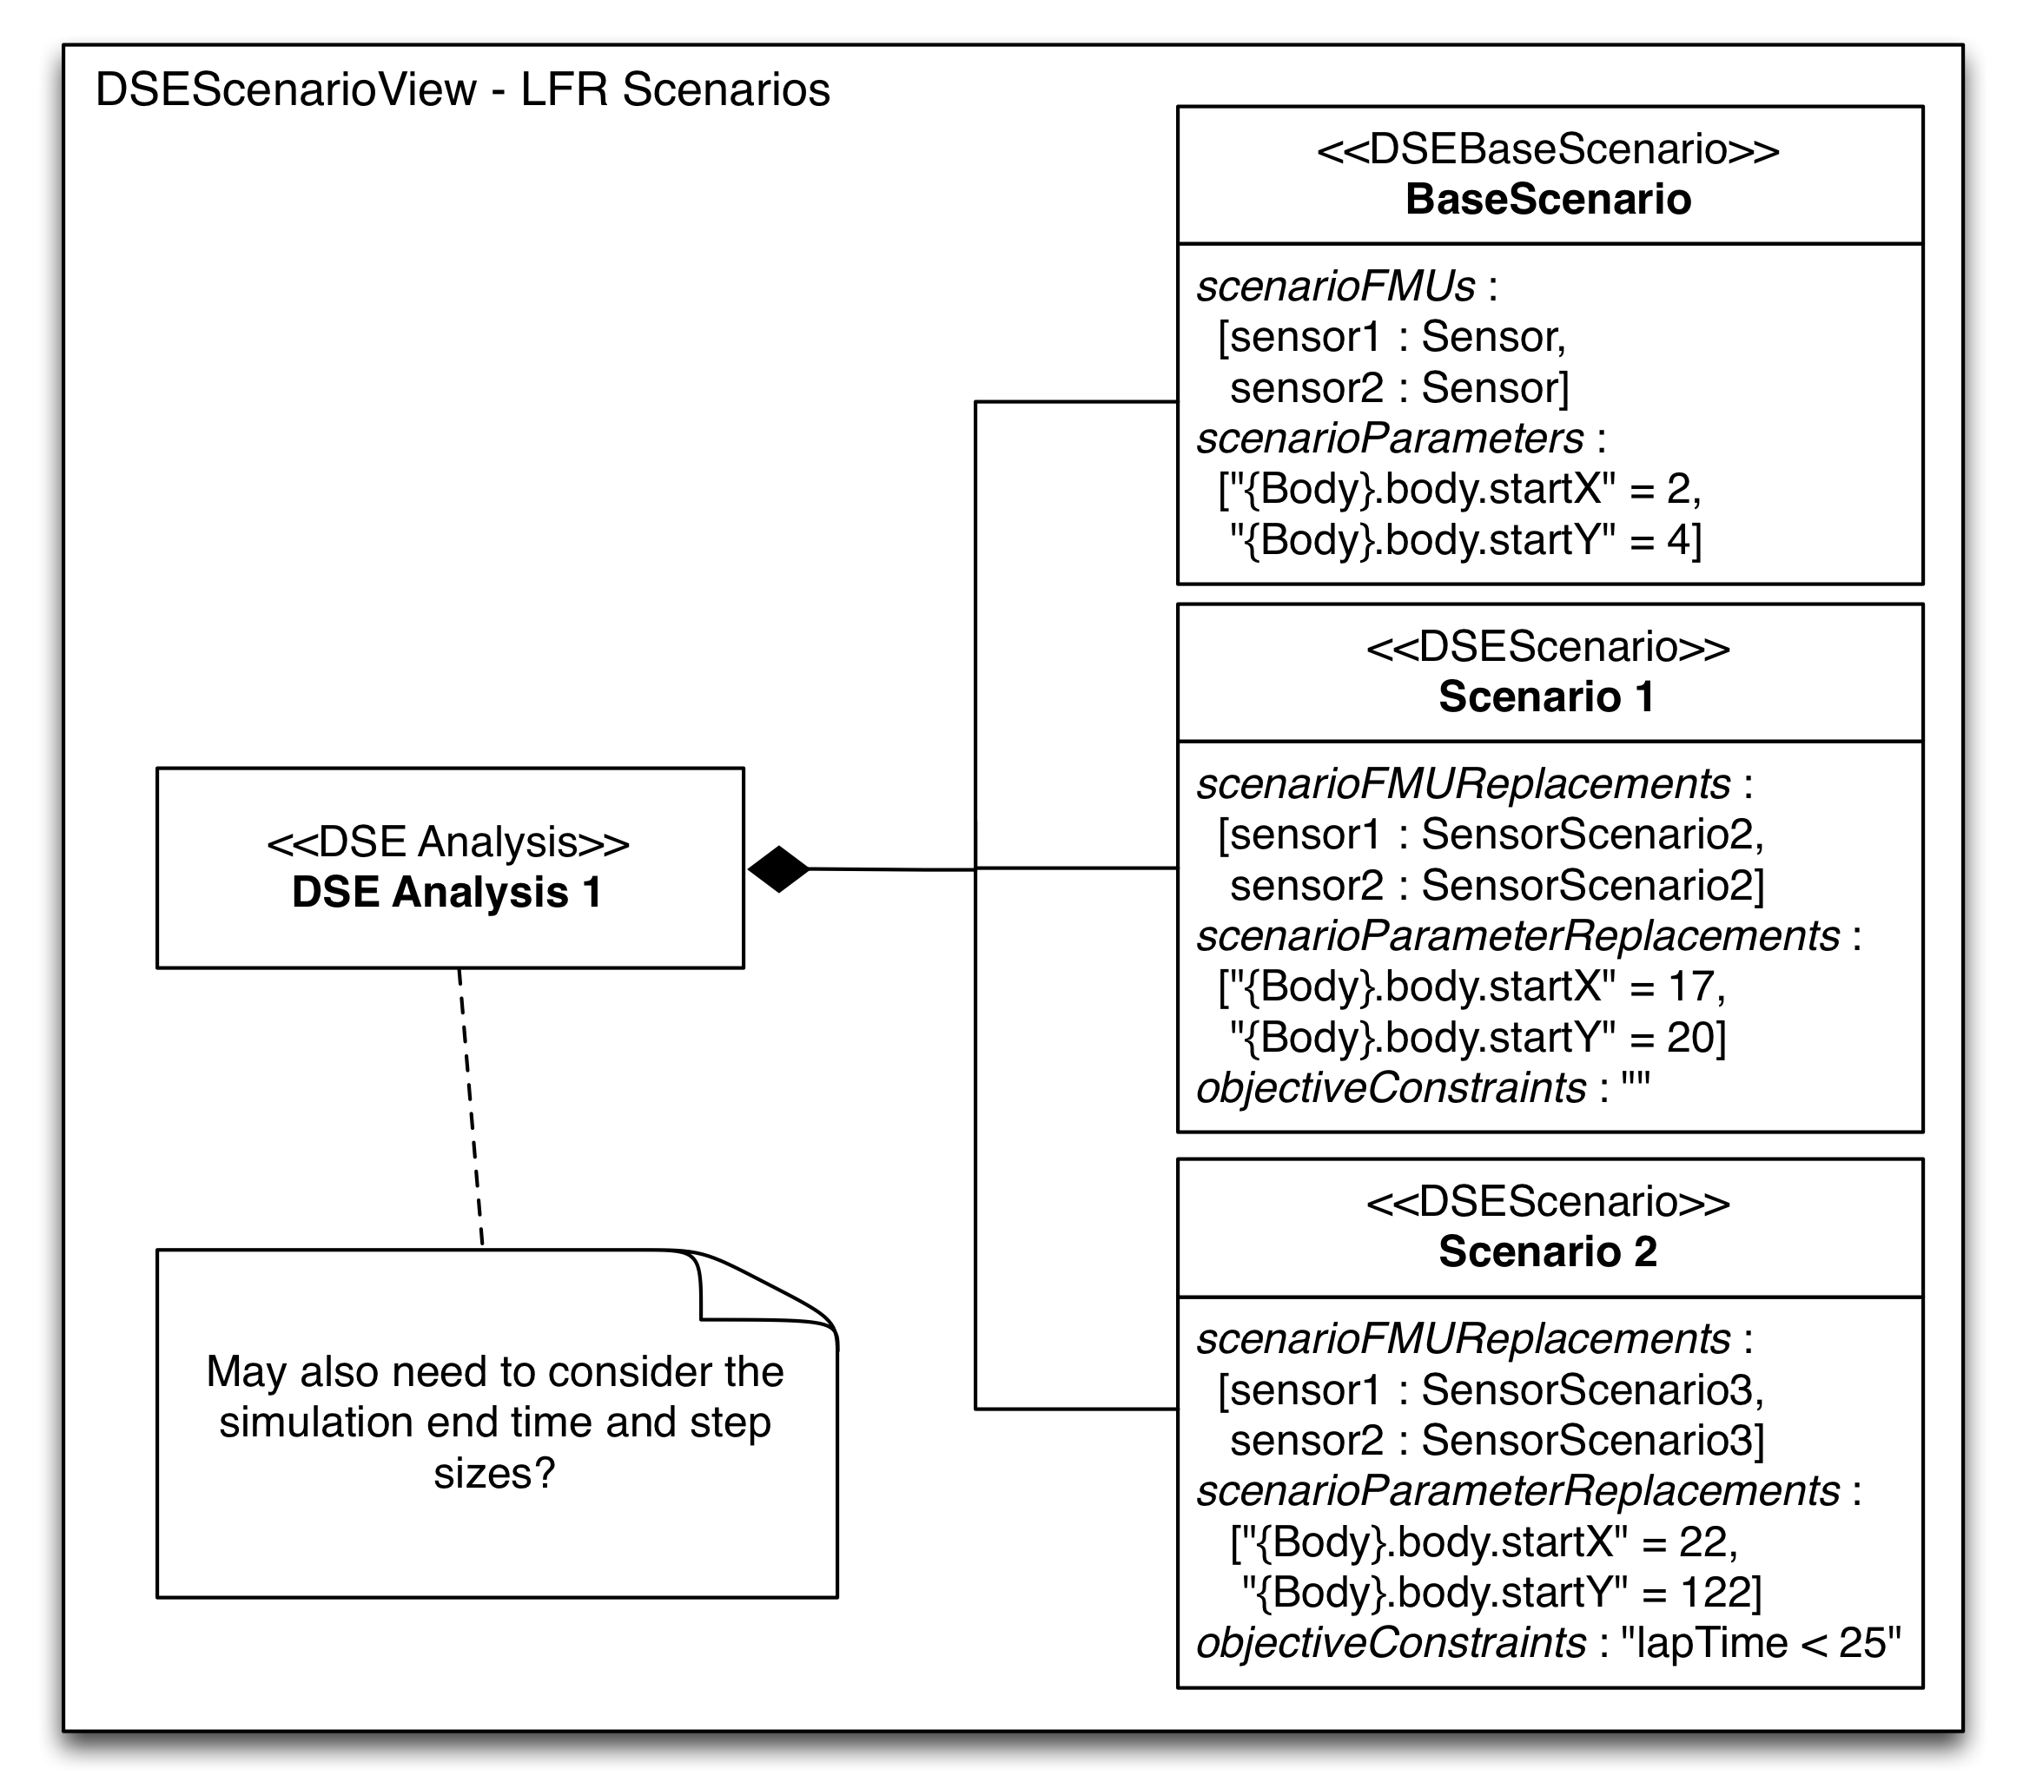
DSE in SysML
A possible view for describing scenarios, this is not currently implemented!
3 Scenarios
Each may define:
FMUs – these change which fmu is used for part of the multi-model
Parameter values – set specific parameters for FMU instances
Objective constraints – used to defined acceptance criteria specific to a scenario
DSE object

Slide 21
DSE Configuration
<name>.dse.json is the file actually used by the DSE scripts
Contains 7 sections (covering slightly more than the DSE profile):
Parameters + constraints
Objectives + constraints
Ranking
Search algorithm + parameters
Scenarios

Slide 22
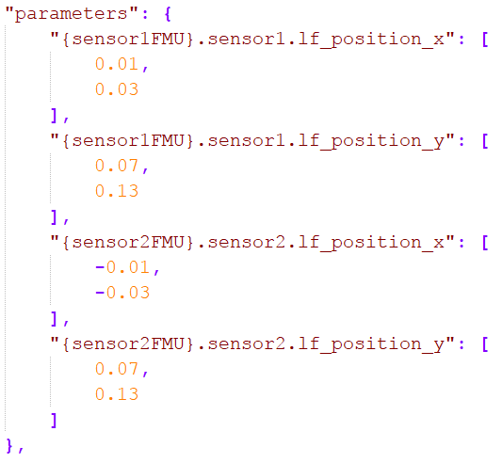
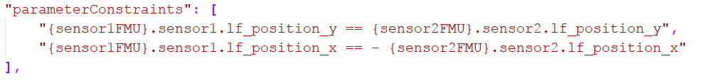
DSE Configuration - Parameters
FMU
Instance
Parameter
List of possible values for each parameter
List of Boolean statements referencing
FMU, instance and parameter. All must be true for a design to be valid

Slide 23
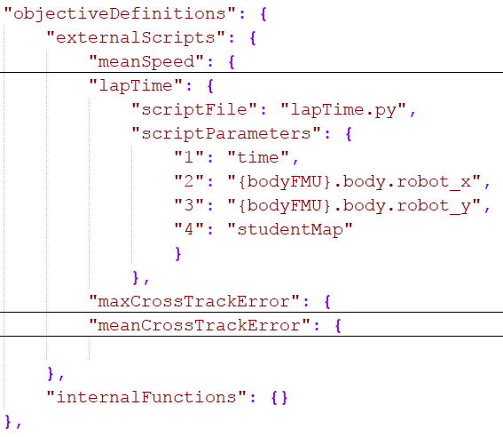
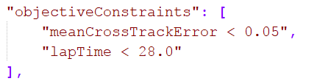
DSE Configuration - Objectives
Objective ID
Filename of the objective script
Arguments needed by the script
(constants or ID of data in results)
Key defining argument order
List of Boolean statements referencing
Objective IDs or constants. All must be true for a design to be accepted

Slide 24
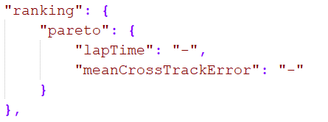
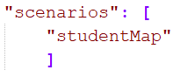
DSE Configuration – Ranking + Scenarios
Ranking method (only Pareto supported currently)
Preference for the objective,
‘-’ = lower
‘+’ = higher
IDs of objectives to be considered
We currently define scenarios as a list of names, these are used to inform the objective scripts which scenario was run

Slide 25
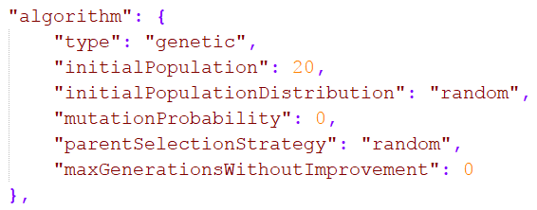
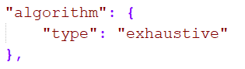
DSE Configuration – Algorithm
Genetic algorithm parameters
Number of designs in the in initial population
Method used to generate the initial population. Only random currently supported but even distribution under development
Probability of a parameter randomly adopting another value when a new design is created [0..100]
Method for selecting parents for subsequent generations. Random means, selection is only influenced by design performance.
After each generation the population of the non-dominated set is examined. This defines how many generations the algorithm will tolerate no changes before it terminates the search and returns results.
The exhaustive algorithm has no parameters

Slide 26
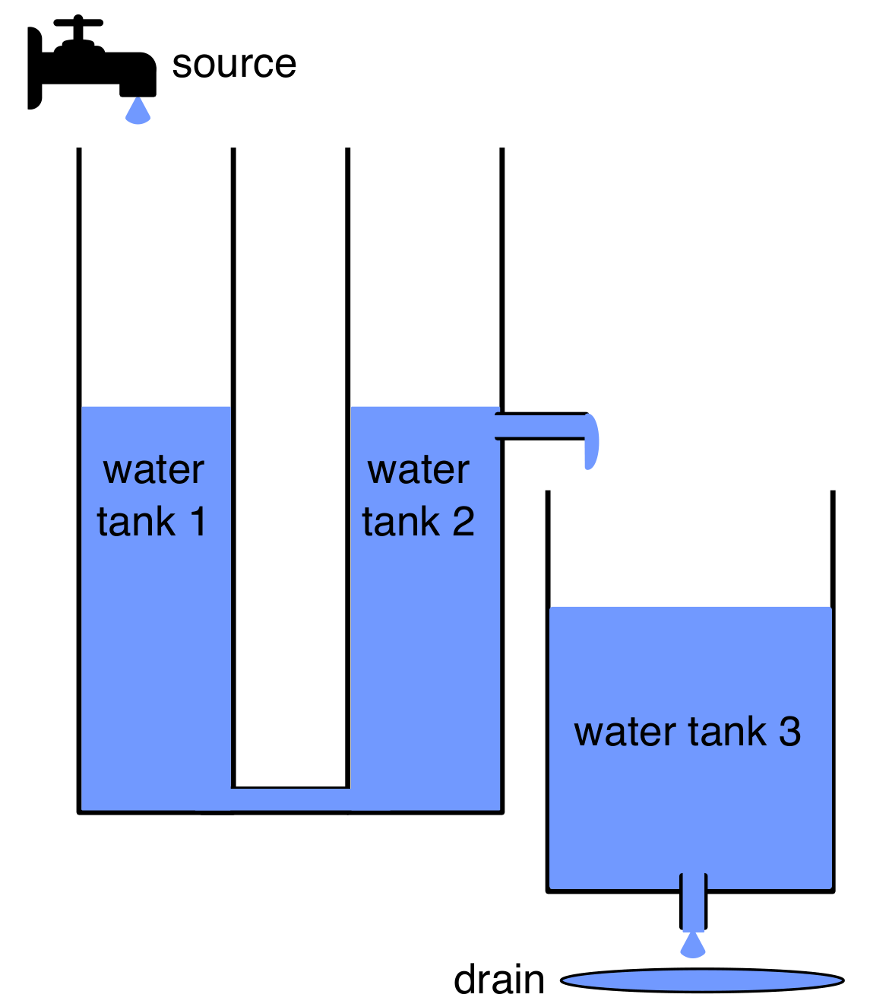
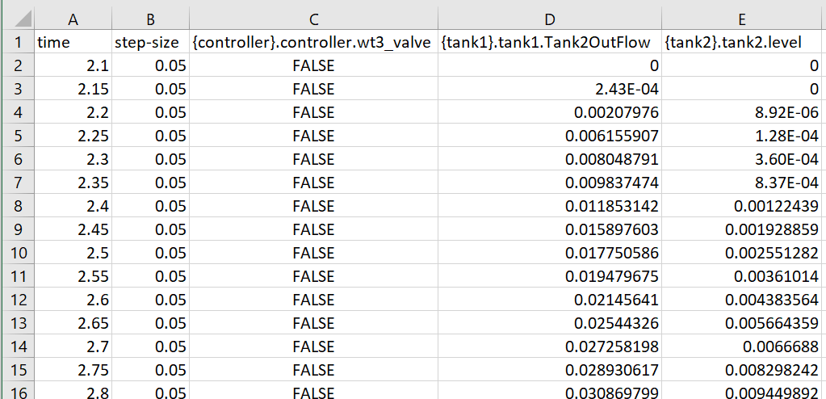
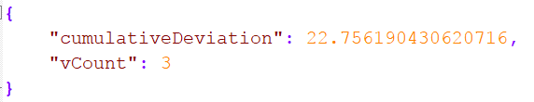
Objectives scripts
Process the raw simulation data to assess performance of the system under test
Following example is from then water tank, the goal is to measure cumulative deviation of water level from a target

Slide 27
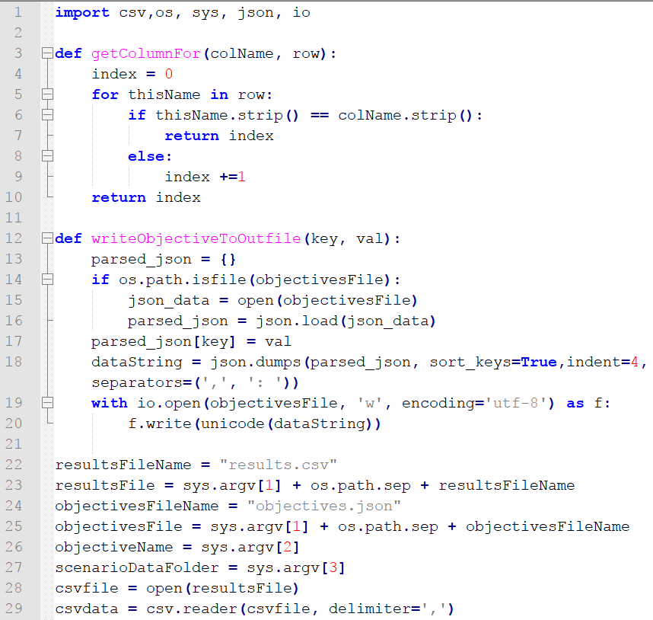
Objectives scripts - common
Common section to all objective scripts
Processes 3 common arguments
[1] Path to results
[2] Objective ID
[3] Scenario ID
Provides helper functions to find the required data and write results to objectives.json

Slide 28
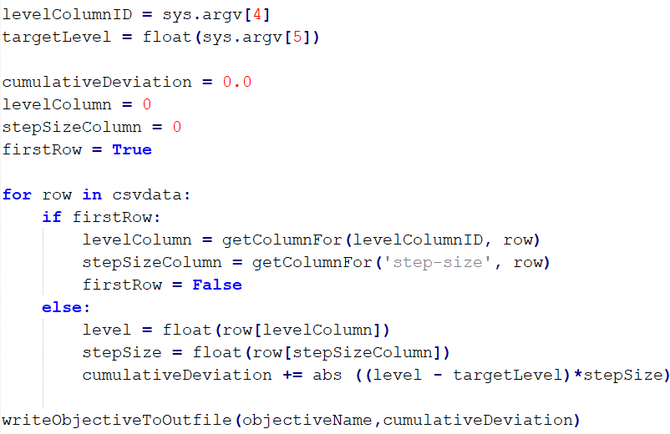
Objectives scripts - specific
Objective specific section
Processes objective specific arguments
[4] Level Column ID
[5] Target level
Computes the value of the objective
Writes the objective value to objectives.json

Slide 29
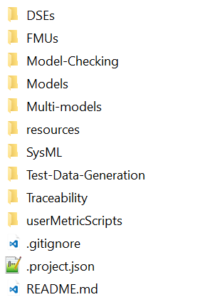
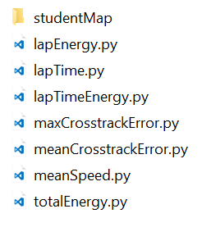
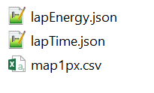
Objectives scripts - scenarios
If scenarios are used, their name is passed to the objective script so it may find any associated data files
Objective scripts are found in ‘userMetricScripts’ directory.
Line follower robot has a scenario called ‘studentMap’, so there is a directory with that name withing ‘userMetricScripts’
Objectives that need scenario specific data may look in this directory for the required data files. E.g. map1px.csv contains map data needed to calculate cross track error

Slide 30
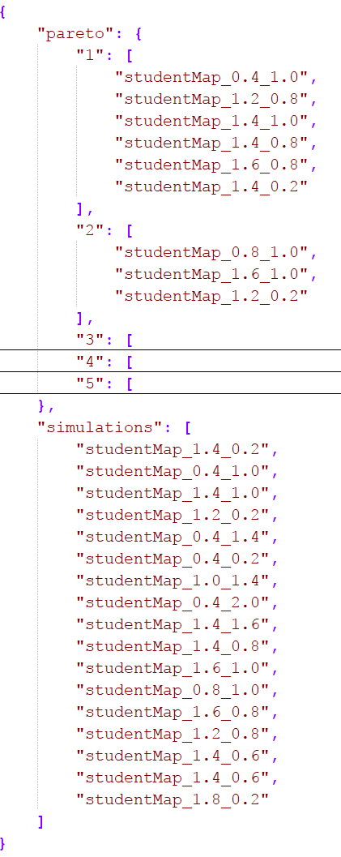
Ranking.json
Used by the DSE scripts to…
Record which simulations have been performed (‘simulations’ section)
Store the ranking information for future processing and presentation (‘pareto’) section

Slide 31
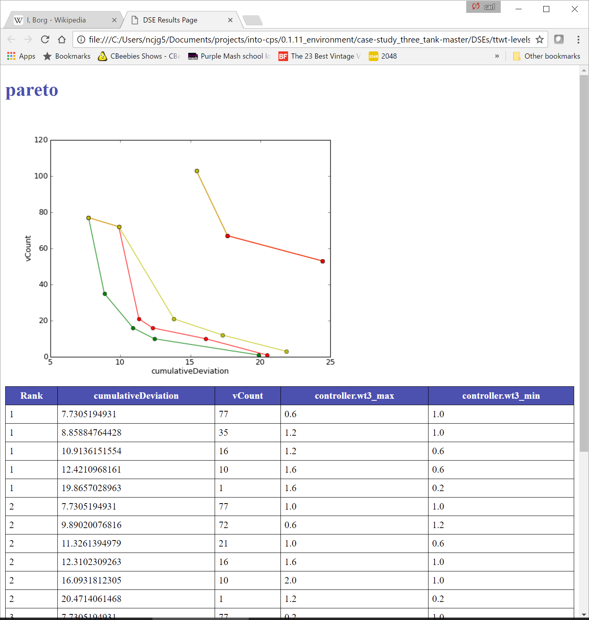
Results.html
Results of DSE presented:
Graphically, each point represents the performance of a design. The green points are the ‘non-dominated set’
Numerically in a table, with rank on the left followed by the objective values and parameters used in each simulation.

Slide 32
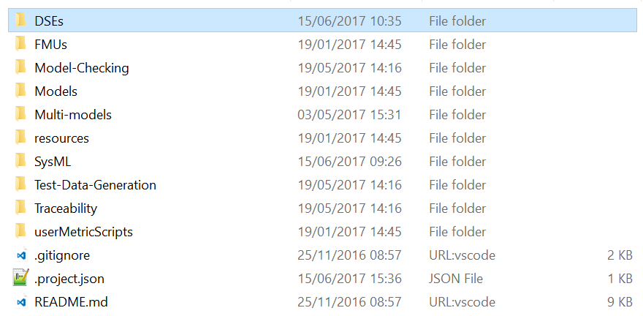
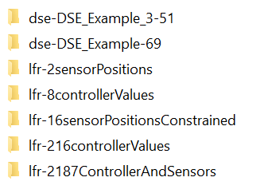
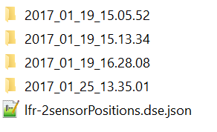
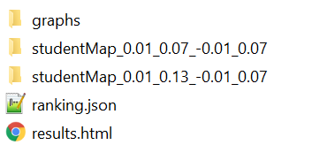
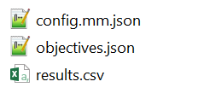
Results Structure
DSE configurations and results all exist in the same folder structure, under ‘DSEs’
Each time a DSE is launched a folder named with the date and time it was launched
Individual simulation results stored in a folder named with the scenario ID and parameters
Each DSE configuration exists in its own folder
HTML and ranking results for the
DSE are stored here
Each simulation has its configuration, raw results and objectives files saved

Slide 33
Demo

Slide 34
Future Directions - Search
Modifications to genetic search
Initial population
Current: randomly generated
Future: allow structured initial population to evenly cover design space or follow user preferences
Parent selection:
Current: random selection influenced by ranking
Future: allow parent selection to be also influenced by location and grouping in designs space and/or objective space
Add a simulated annealing search algorithm
Allow architecture and scenario sweeping with results presented in a sensible manner

Slide 35
DSE in the cloud
DSE can require much CPU time, even with genetic search
DSE may be democratised by supporting the use of cloud resources
Making used of HTCondor we have automated much of the process already and aim to automate the remainder over the summer
https://research.cs.wisc.edu/htcondor/
User PC
Submit Node
Compute Nodes 1 .. n
Start DSE
FMUs/objective scripts
Batch of model configs
1 config per node
DSE Loop
Request progress
Request progress
Fetch Results + objectives
Result + objectives
Present results

Slide 36
DSE in the cloud
Cloud-based DSE
trade-offs
Users are charged for both cpu time and data transferred
Organisations may have different goals in terms of design cost, time and diversity
We aim to provide guidance on how to employ cloud parallelism to meet organisational needs
2 offspring
init
1
2
3
4
5
Generation (time)
5 offspring
init
1
2
3
4
5
Generation (time)
36

Slide 37
Hands on Tutorials
There are three tutorials that will be made available in the area of DSE:
Tutorial 5: SysML for DSE – How to create the SysML views describing DSE and exporting this to the app.
Tutorial 6: Editing and Launching DSE – How to edit the DSE configuration in the app, how to launch a DSE and an overview of the results
Tutorial 7: Objective Scripts – Creating objective scripts with examples from the water tank and line follower robot examples
37

Slide 38
A DSE Workflow (Tutorials)
Requirements
Multi-model
Tutorial 5
DSE Analysis
Modelio
DSE Analysis Model
Tutorial 7
Configuration Export
Modelio
Objective Scripting
Python/Java
DSE Configuration
Objective Scripts
Configuration Editing
INTO App.
Tutorial 6
DSE Configuration
Launch DSE
INTO App.
Simulation Results
Objective Results
Ranking Results

Slide 39
Design Space Exploration Introduction
Carl Gamble, Newcastle University
www.into-cps.org

